Slide 1
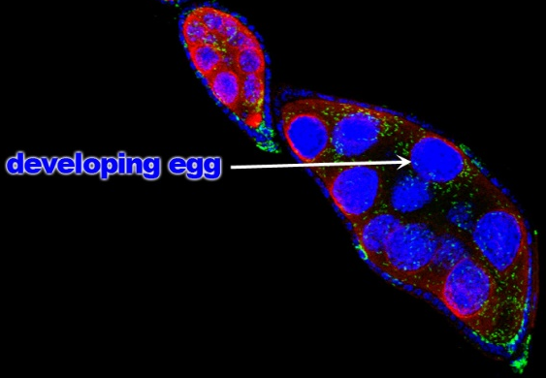
Methods for DNA Extraction
First, we smashed up the insect using a small explosion using dynamite. Next, we incubated the sample in hot sulfuric acid to break down the barriers to DNA. A paper towl was used to trap the DNA in the sample after precipitation with dirt from outside. We washed the membrane with Windex and used the centrifuge to get all the extra contamination off the membrane, and last we used old chemicals from the chemistry stock room to remove the DNA from the paper towel.

Slide 2
Results:
The corrected absorbance for my DNA extraction sample was 0.25, and I used this to calculate a DNA concentration of 12.5. The A280 absorbance of the protein in the sample was a corrected value of 0.129. This gave an overall ration of 1.94, which is a high quality DNA sample. The conclusion for this exercise is that there might not be very much DNA in the sample, but what is there is high quality and not contaminated.

