Slide 1
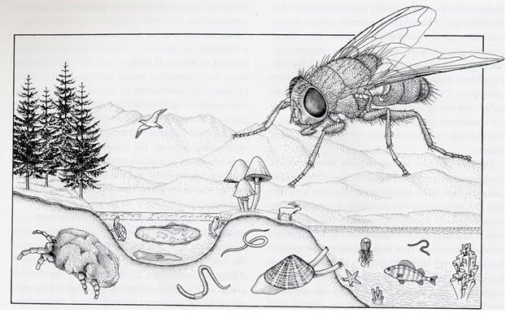
Diversity of insects
designtrust.blogspot.com

Slide 2
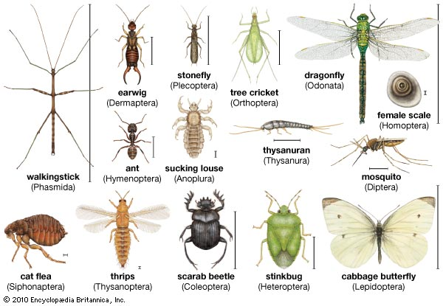
Insect Diversity
ww.britannica.com

Slide 3
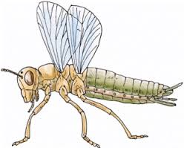
General Insect Anatomy (pg 38 of Lab Manual, 9th ed)
www.web-shops.net

Slide 4
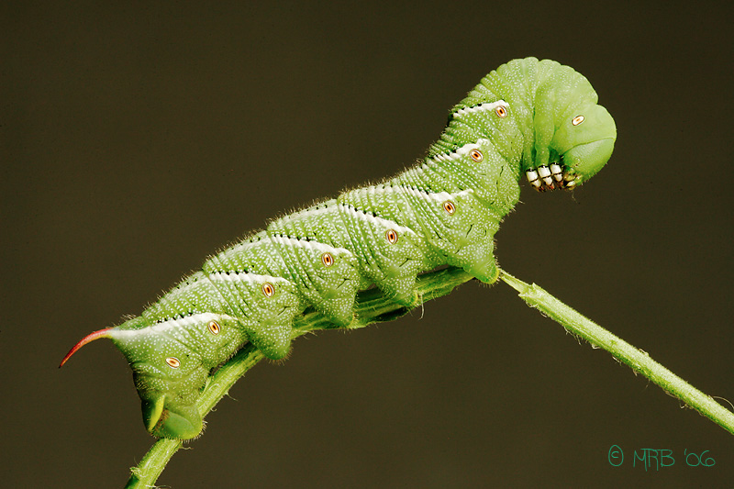
True Legs
grapeseedfarmproject.wordpress.com

Slide 5
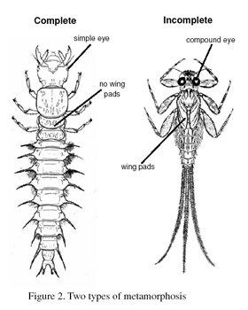
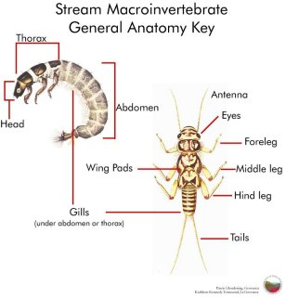
pubs.ext.vt.edu
www.dnr.state.md.us

Slide 6
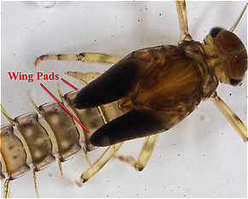
Immature insects—wing development Wing pads
www.troutnut.com
www.missouribotanicalgarden.org
Can you differentiate the immature and mature specimens?

Slide 7
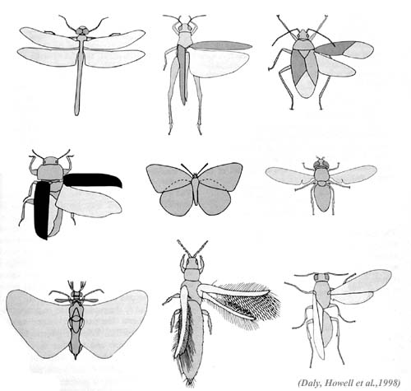
Insect Wings
Odonata
Hemiptera
Orthoptera
Lepidoptera
Diptera
Coleoptera
Hymenoptera

Slide 8
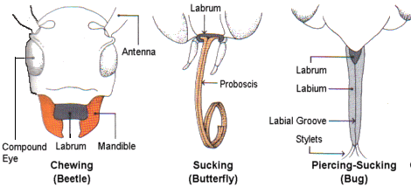
Mouthparts
www.robinsonlibrary.com

