Slide 1
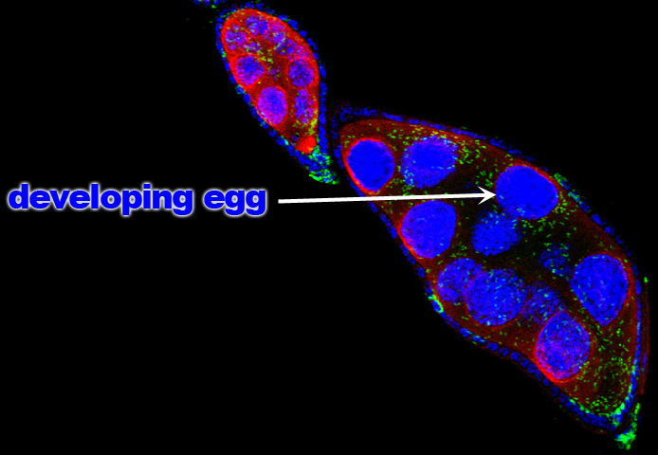
Methods for DNA Extraction
Smash insect with small explosion using dynamite.
Disrupt barriers using sulfuric acid.
Remove contaminants with Windex.
Obtain DNA from the extracter using old chemicals found in the chemistry stock room.
http://whyfiles.org/2011/a-story-of-the-bacterium-and-the-fly/
KM

Slide 2
DNA Extraction Results:
A260 (corrected): 0.25
A280 (corrected): 0.129
DNA concentration: 12.5 ng/ul
A260/A280 Ratio: 1.94
Overall Conclusions:
Low concentration of DNA
Highly enriched product (very little protein contamination)
KM

